Slide 1
Human Computer Interaction (HCI) Lecture 1

Slide 2
Human Computer Interface?
HCI is not just about software design
HCI applies to more than just desktop PCs!!!
No such thing as “the best HCI”. Choice of interface will depend on:
  Physical environment
  Experience of users
  Amount of info that needs to be gathered/conveyed

Slide 3
Good Interface Design 1
Users should be able to use an interface:
SAFELY
Tasks can be completed without risk – e.g. flying an aeroplane.
EFFECTIVELY
Being able to do the right task and do it well – e.g. videoing a TV programme
EFFICIENTLY
To carry out tasks quickly and correctly – e.g. at a cashpoint
ENJOYABLY
Users should be able to enjoy what they are doing, not be frustrated by the interface – e.g. educational programs

Slide 4
Good Interface Design 2
There are four considerations for an interface designer:
WHO
Who is going to use the system, what are their ages, etc.?
WHAT
What tasks are they likely to want to perform? Repetitive, complex, simple, etc.
ENVIRONMENT
Where is the computer to be used? In a hazardous or noisy environment?
What is technologically available? Designers should not add elements to the interface that cannot actually be used out easily.
FEASIBILITY

Slide 5
User Interfaces – 4 Types
1. Command Line Interface (CLI)
  A CLI displays a prompt, the user types a command on the keyboard and executes the command. The computer executes the command, providing textual output.
2. Menu Driven Interface
  The user has a list of items to choose from, and can make selections by highlighting one.

Slide 6
User Interfaces – 4 Types
3. Graphical User Interface (GUI)
  Uses windows, icons, menus and pointers (WIMP) which can be manipulated by a mouse (and often to an extent by a keyboard as well).
4. Natural Language Interface
  Can range from simple command systems to voice activated text processing. Commands are spoken in “normal” language.

Slide 7
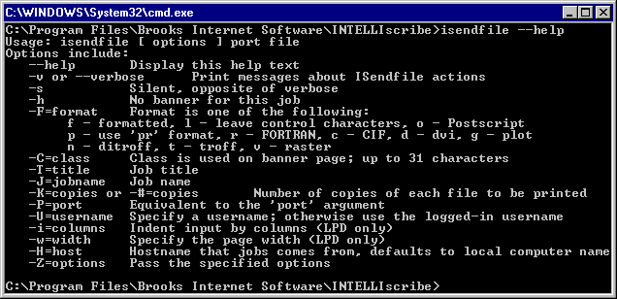
Command Line Interfaces 1
Advantages
  Very flexible with the use of “switches” (options)
  Good for “expert”
  users - can quickly
  access commands
  Uses the fewest
  system resources

Slide 8
Command Line Interfaces 2
Disadvantages
  Requires the user to learn “complex” commands or language
  “Hidden” features i.e. if you don’t know the commands you wont know the features are there!
  Not very good for novice users

Slide 9
Command Line Interfaces 3
Command Line Interface Applications
  System administration
  Engineering applications
  Scientific applications

Slide 10
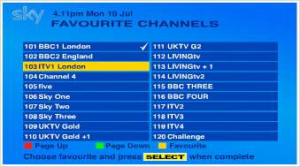
Menu Driven Interfaces 1
Advantages
  No need to learn complex commands/language
  Easier for a novice
  to learn/use
  Ideal when there are
  a limited number of
  options (efficient)

Slide 11
Menu Driven Interfaces 2
Disadvantages
  Can be frustrating for experienced users i.e. the command they want to use is buried 5 levels deep!!!!
  User interface may be limited by screen space and number of options available

Slide 12
Menu Driven Interfaces 3
Menu Driven Applications
  ATM
  Mobile Phone
  MP3 Player
  Video recorder
  Household Devices
  Digital/Cable TV

Slide 13
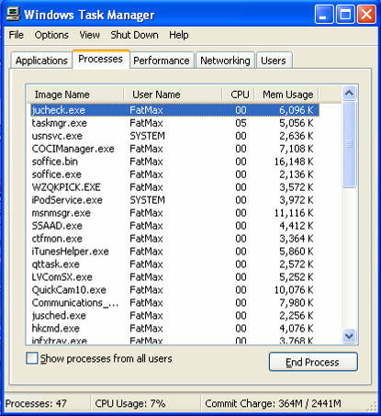
Graphical User Interfaces 1
Most suitable interface
for inexperienced or
novice users but…
GUIs use more system
resources than other
types of interface

Slide 14
Graphical User Interfaces 2
Many generic packages for a GUI will share common features
  Layout of the screen
  Names given to
  commands
  Icons
  Order of menus
  Mouse operation
  Dialog boxes

Slide 15
Benefits of a common interface
There are five advantages to the ‘common user interface’:
1 Increased speed of learning
2 Ease of use
3 Confidence for novice users
5 Greater range
of software
available to
the average
computer user
4 Increase the range of
solvable tasks by users

Slide 16
Natural Language Interfaces 1
Advantages
  No training required – you just tell the computer what you want to do!
  Can be quicker than keyboard entry
  Hands-free – could be invaluable in some environments

Slide 17
Natural Language Interfaces 2
Disadvantages
  Emerging technology – still contains “bugs”
  Difficulty dealing with homonyms
  Difficult to recognise all the different ways of saying things (and regional dialects)
  Artificial languages are often more precise

Slide 18
THANKS

